Slide 1
Azure governance and compliance
Ensuring Security And Compliance In Cloud

Slide 2
Introduction
Azure governance and compliance are essential concepts in the world of cloud computing, especially when it comes to Microsoft Azure.

Slide 3
Governance
Governance refers to the framework of practices, policies, and procedures put in place to ensure that a cloud environment, like Azure, is well-managed.
It involves making decisions and setting rules that guide how resources and services are provisioned, utilized, and secured within Azure.
Compliance
Compliance is all about adhering to laws, regulations, and industry standards that are applicable to an organization’s operations.
In the context of Azure, compliance means that the cloud resources and data stored in Azure comply with relevant legal requirements and security standards.

Slide 4
Polices in azure governance
These policies help organizations maintain compliance, security, and consistent resource management.
Azure Security policy
Azure Subscription policy
Creating a policy

Slide 5
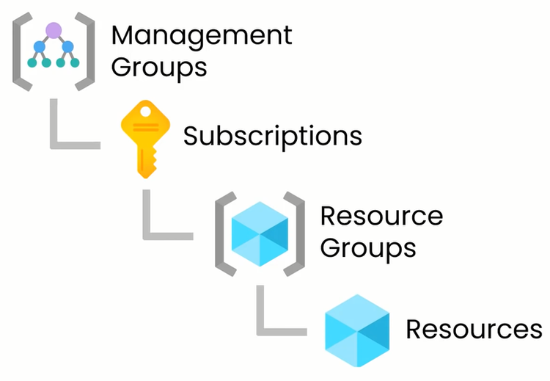
Management group, subscription, resource group and resources in azure
The hierarchy starts with management groups at the top, which can contain subscriptions, and each subscription can contain one or more resource groups. Within resource groups, you can place individual resources.

Slide 6
Locks in azure
In Azure, locks are a feature used to prevent accidental or unauthorized changes to critical Azure resources. They provide an additional layer of security and protection for important resources.
Types of Locks: Read-Only Lock (CanNotDelete)
Delete Lock (ReadOnly)

Slide 7
Benefits of Azure Governance and Compliance
Security
Auditability
Cost Control
Efficiency
Risk Mitigation
Resource Management
Scalability
Standardization

Slide 8
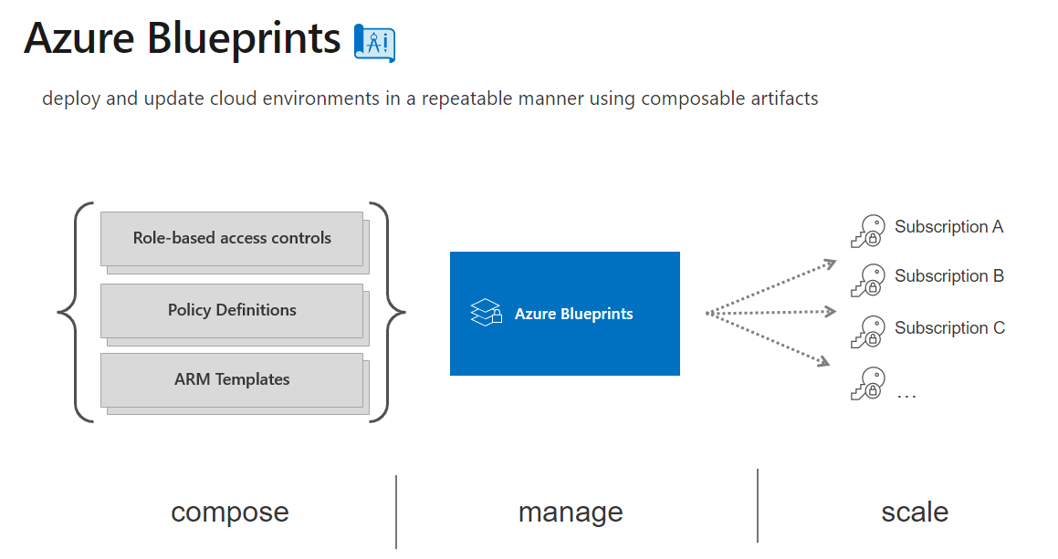
Blue prints in azure
In Microsoft Azure, Azure Blueprints is a service that simplifies the process of setting up and creating repeatable environments that adhere to organizational standards, compliance requirements, and best practices.

Slide 9
Challenges
Complexity of Cloud Ecosystem
Changing Regulatory Landscape
Resource Sprawl
Overly Restrictive Policies
Monitoring and Alerting

Slide 10
THANK YOU

